Slide 1
TUT04 – Machine Language I COMP1411: Introduction to Computer Systems
Dr. Mingsong LYU
Department of Computing
The Hong Kong Polytechnic University
Spring 2023
These slides are only intended to use internally. Do not publish it anywhere without permission.

Slide 2
Question 1
For each of the following instruction, fill in the suitable suffix based on the operands. (e.g., use movb, movl, movw, movq). The architecture is X86-64.
mov__ %eax, (%rsp)
mov__ $0xFF, %bl
mov__ (%rdx), %rax
mov__ %dx, (%rax)

Slide 3
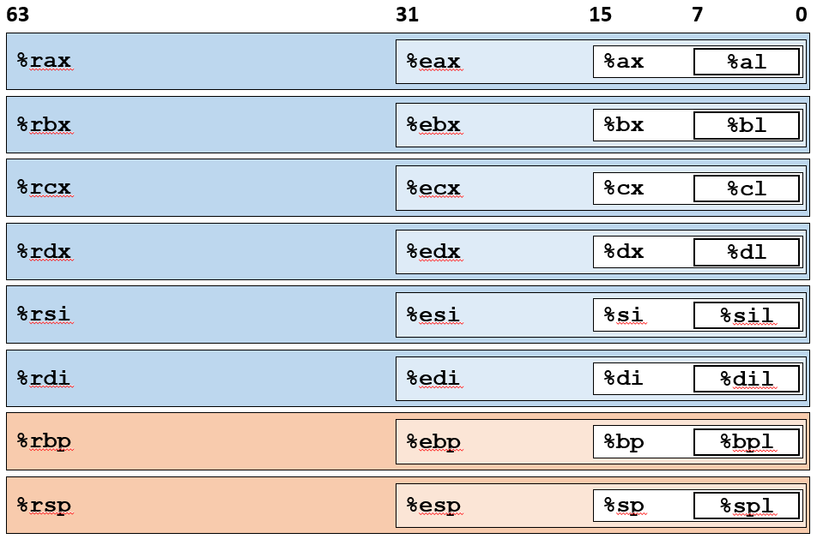
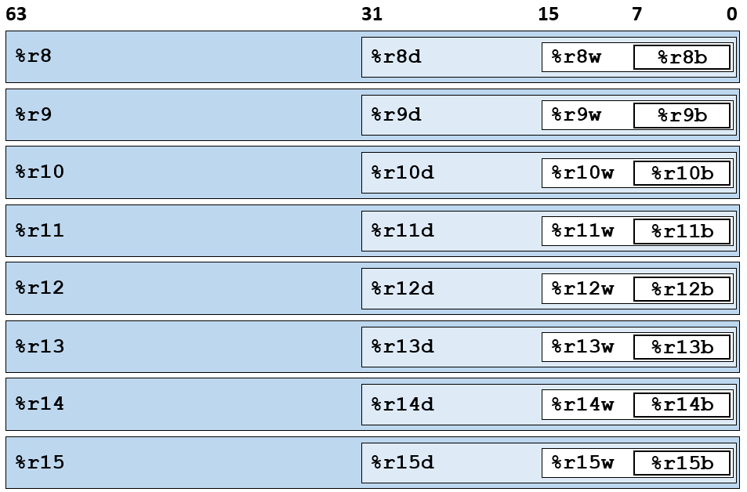
Question 1
To learn
X86-64 arch has 64-bit registers, but one can access the lower bits by different instructions
Instruction suffix
**q → 8 bytes; **l → 4 bytes; **w → 2 bytes; **b→ 1 byte
Names of the registers

Slide 4
Question 1
Solution and explanations
mov__ %eax, (%rsp)
Register → memory
%eax is 4-bytes
mov__ $0xFF, %bl
Immediate → register
%bl is 1-byte
mov__ (%rdx), %rax
Memory → register
%rax is 8-byte
mov__ %dx, (%rax)
Register → memory
%dx is 2-byte
l
b
q
w

Slide 5
Question 2
The architecture is X86-64.
Suppose that the following function void decode(long *xp, long *yp, long *zp) is compiled into the following assembly code.
movq (%rdi), %r8
movq (%rsi), %rcx
movq (%rdx), %rax
movq %r8, (%rsi)
movq %rcx, (%rdx)
movq %rax, (%rdi)
ret
Suppose that parameters xp, yp, zp are stored in registers %rdi, %rsi, and %rdx respectively.
Guess the C code of the function decode.
void decode(long *xp, long *yp, long *zp) {
……
……
}

Slide 6
Question 2
Instruction | C-code | notes
movq (%rdi), %r8 | t1 = *xp | %rdi = xp, (%rdi) = *xp, t1 allocated to %r8
movq (%rsi), %rcx | t2 = *yp | t2 allocated to %rcx
movq (%rdx), %rax | t3 = *zp | t3 allocated to %rax
movq %r8, (%rsi) | *yp = t1
movq %rcx, (%rdx) | *zp = t2
movq %rax, (%rdi) | *xp = t3 | %rax is the default register for return value
ret | --- | Nothing will be returned for this function
void decode
(long *xp, long *yp, long *zp) {
long t1 = *xp;
long t2 = *yp;
long t3 = *zp;
*yp = t1;
*zp = t2;
*xp = t3;
}
Register | value
%rdi | xp
%rsi | yp
%rdx | zp
*yp
*zp
*xp

Slide 7
Question 3
Suppose that the following function long arith(long x, long y, long z) is compiled into the following assembly code:
arith:
orq %rsi, %rdi
sarq $3, %rdi
notq %rdi
movq %rdx, %rax
subq %rdi, %rax
ret
Suppose that parameters x, y, z are stored in registers %rdi, %rsi, and %rdx respectively. Guess the C code of the function arith.
long arith(long x, long y, long z) {
long t1 = __________________;
long t2 = __________________;
long t3 = __________________;
long t4 = __________________;
return t4;
}

Slide 8
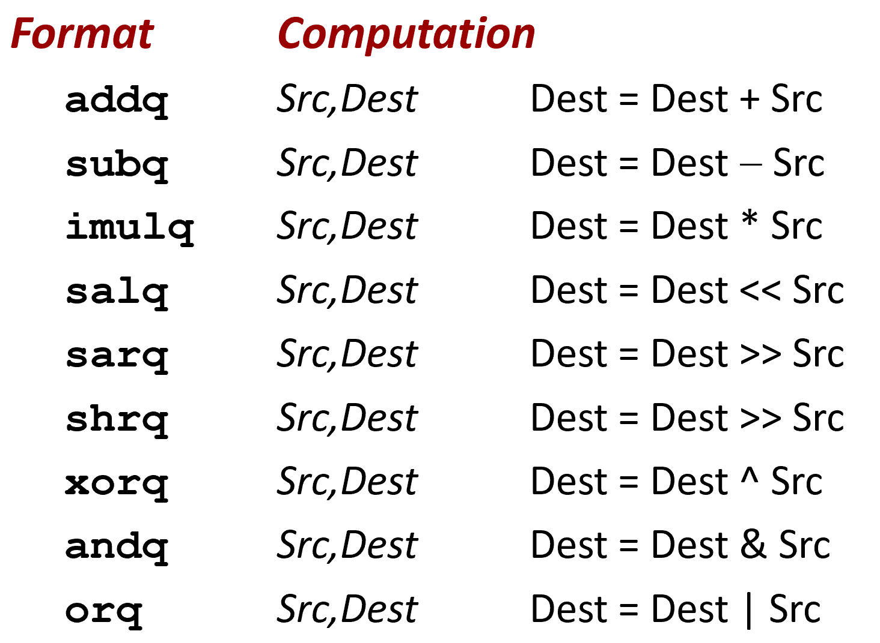
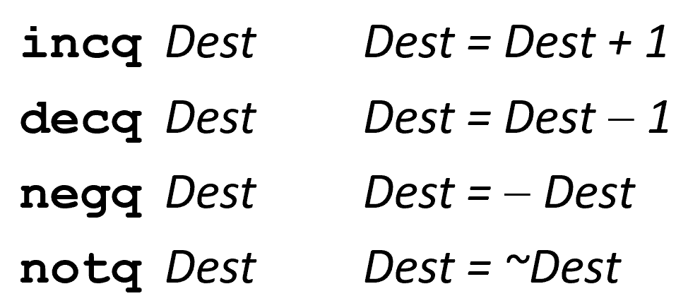
Question 3
To learn
Main arithmetic/logical/bit operations in X86-64

Slide 9
Question 3
orq %rsi, %rdi
Logical operation bitwise or
Operands: x and y
Results stored in %rdi
t1 = x | y;
t1 → %rdi
Register | value
%rdi | x
%rsi | y
%rdx | z

Slide 10
Question 3
orq %rsi, %rdi // t1 = x | y
sarq $3, %rdi
Right arithmetic shift by 3 bits
Operand: t1
Results stored in %rdi
t2 = t1 >> 3;
Register | value
%rdi | x, t1
%rsi | y
%rdx | z

Slide 11
Question 3
orq %rsi, %rdi // t1 = x | y;
sarq $3, %rdi // t2 = t1 >> 3;
notq %rdi
Logical bitwise negation
Operand: t2
Results stored in %rdi
t3 = ~t2;
Register | value
%rdi | x, t1, t2
%rsi | y
%rdx | z

Slide 12
Question 3
orq %rsi, %rdi // t1 = x | y;
sarq $3, %rdi // t2 = t1 >> 3;
notq %rdi // t3 = ~t2;
movq %rdx, %rax
Data movement, rom %rdx to %rax
Operands: z, t4
Results (t4) stored in %rax
t4 = z;
Register | value
%rdi | x, t1, t2, t3
%rsi | y
%rdx | z
%rax | t4

Slide 13
Question 3
orq %rsi, %rdi // t1 = x | y;
sarq $3, %rdi // t2 = t1 >> 3;
notq %rdi // t3 = ~t2;
movq %rdx, %rax // t4 = z;
subq %rdi, %rax
Arithmetic operation subtraction
Operands: t3, t4
Results stored in %rax
t4 = t4 – t3;
t4 = z - t3;
Register | value
%rdi | x, t1, t2, t3
%rsi | y
%rdx | z
%rax | t4

Slide 14
Question 3
long arith(long x, long y, long z) {
long t1 = x | y;
long t2 = t1 >> 3;
long t3 = ~t2;
long t4 = z – t3;
return t4;
}

Slide 15
Thank You

